Slide 1
Using NLP and unsupervised learning For Movie Script Analysis
Matt Tranquada – GA-BOS-DSI+3

Slide 2
Concept
Film scripts provide a unique kind of domain-specific text to examine using NLP
As the name “scripts” suggests, film scripts are a product-oriented type of document, typically structured somewhat like a play but also governed by standard types of instructions aimed at coordinating story, action, dialogue, and camera
As a “scripting language”, film scripts have some interesting features:
Linearity vs. modularity: scripts must ultimately describe a linear narrative, but as a guide for work it also needs to be easy to identify and parallelize common scenes
Scripting of discursive “objects”: almost all film scripts provide some way to distinguish between camera directions, dialogue, and stage directions – however formatting varies heavily between directors and draft states

Slide 3
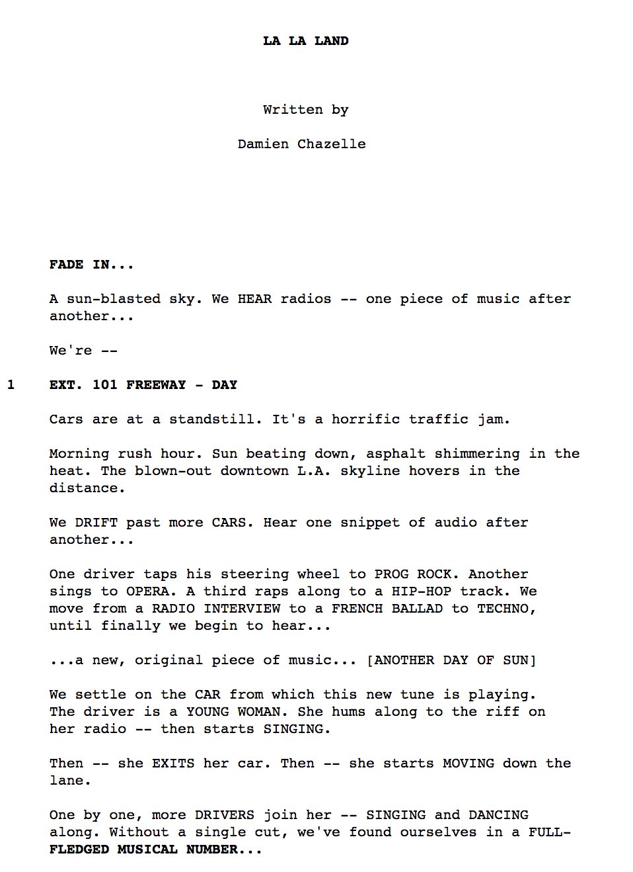
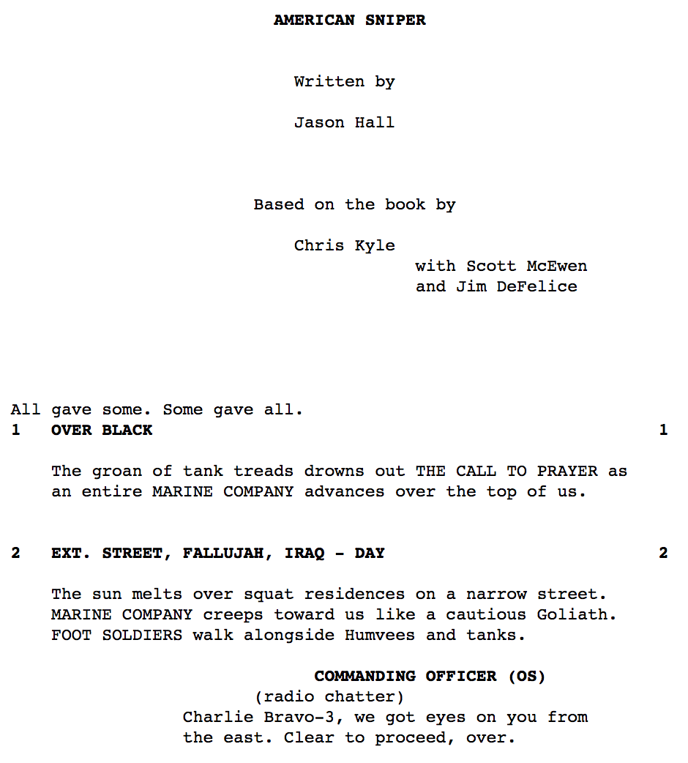
Example Scripts

Slide 4
Example Scripts

Slide 5
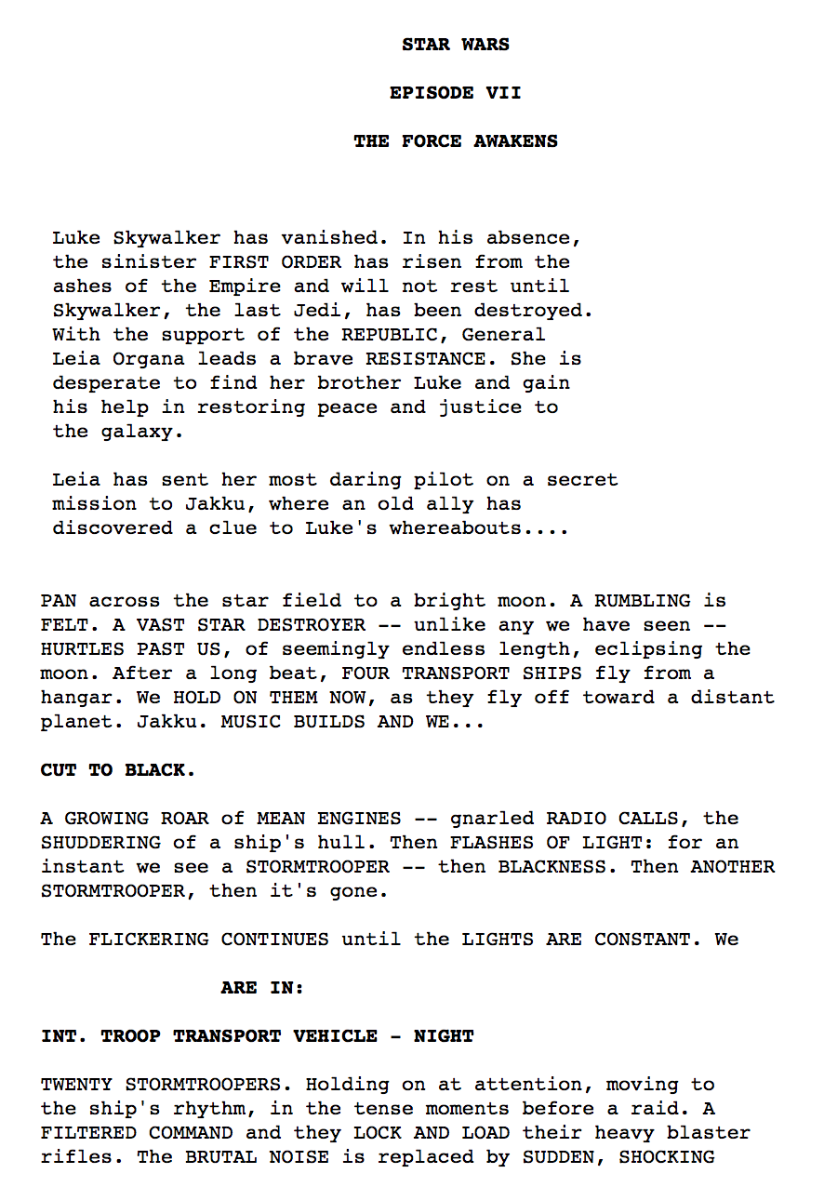
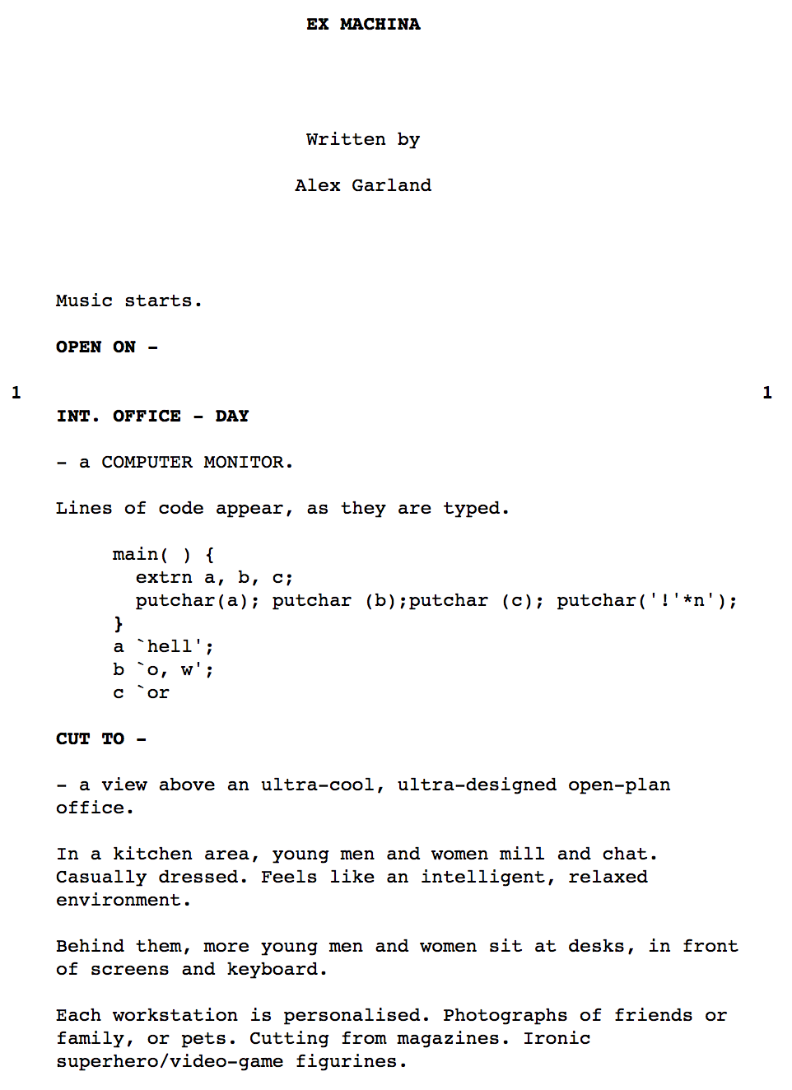
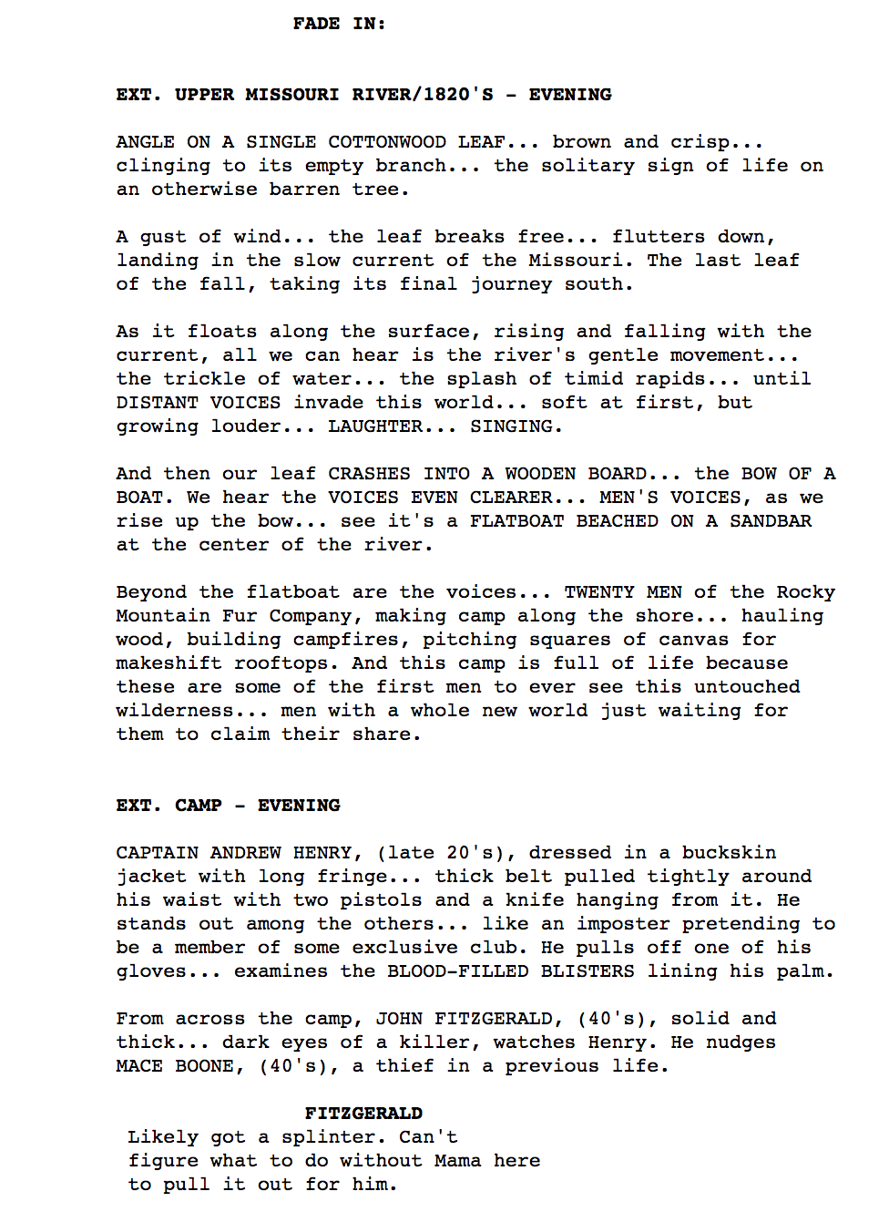
Example Scripts

Slide 6
Data Sources
Scripts
Internet Movie Script Database (IMSDb)
Currently 1171 scripts in database – Covers scripts produced for films between ~1930s and 2016
Heavily skewed towards scripts from mid-1980s to present
~600 movies lacking correct date meta-information for drafts (may be in texts)
Captured 1122 scripts successfully via webscraping – 48 errors mostly due to PDFs
Films
Internet Movie Database (IMDb)
Still joining IMDb data on scripts, but at least 78 of the IMDb Top 250 films are in the script dataset
IMDb data allows extraction of info on characters, directors, box office receipts, etc.

Slide 7
Problem Analysis
Structural interpretation – how do you teach a computer to understand a script at the structural level?
Supervised learning (logistic reg, bagging/boosting ensemble models, neural networks, CNNs)
Unsupervised learning (PCA, LDA, clustering)
Semantic interpretation – how can a computer model the inherent structures within scripts to enable robust quantitative analysis?
Network analysis and comparison
Topic modeling
Adaptive feature extraction

Slide 8
Project Goals - Primary
Develop NLP-oriented text data enrichment techniques with an eye towards automating semantic analysis
Make script texts into useful analytical objects
Develop structural analysis techniques using predictive NLP and ML techniques to infer variations in embedded object structures
Infer script structures using multi-dimensional text analysis
Use tools like graph networks to represent and visualize key structures of script texts
Extract and represent key text objects and structures

Slide 9
Project Goals - Secondary
Create multi-dimensional text processing tools that can potentially be used for texts in other domains
Experiment with local database structures in SQLite3 to support both ML analysis and visualizations
Create interactive dashboards that allow users to explore (and audit) the data at different levels
Experiment with predictive models to see how script-level features (such as narrative structures, keywords, use of tropes, etc.) can be used to predict performance, sentiment, cost, etc.
May require additional data

Slide 10
Script processing – 5 Layer model
IMSDB
IMDb
L0: Raw Text
L1: Text -> Lines
PROJ DB
L2: Lines -> Tokens
L3: TOKENS -> Objects
L4: Objects -> Entities

Slide 11
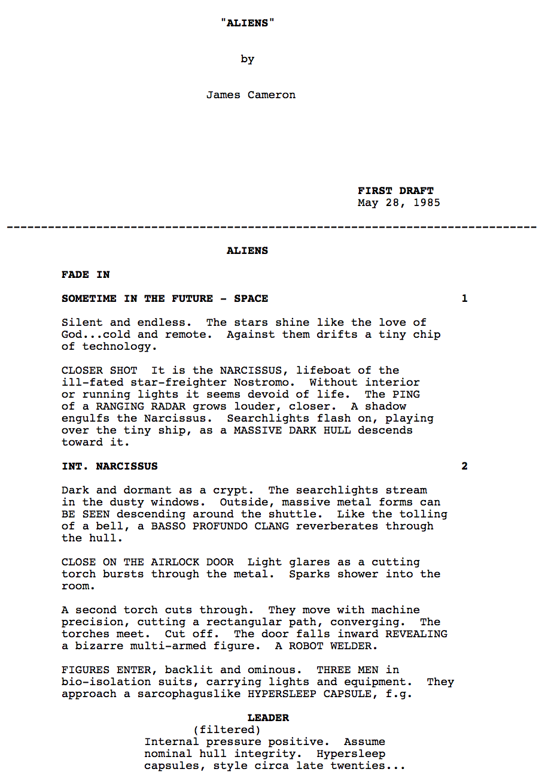
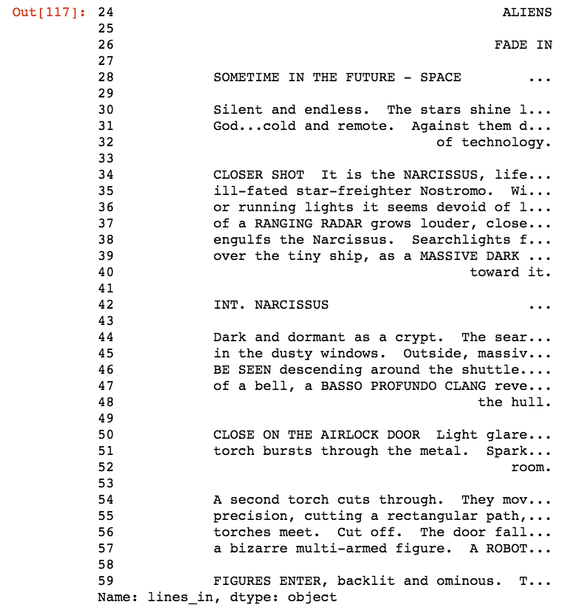
Example: Aliens (L0 vs L1)
Split

Slide 12
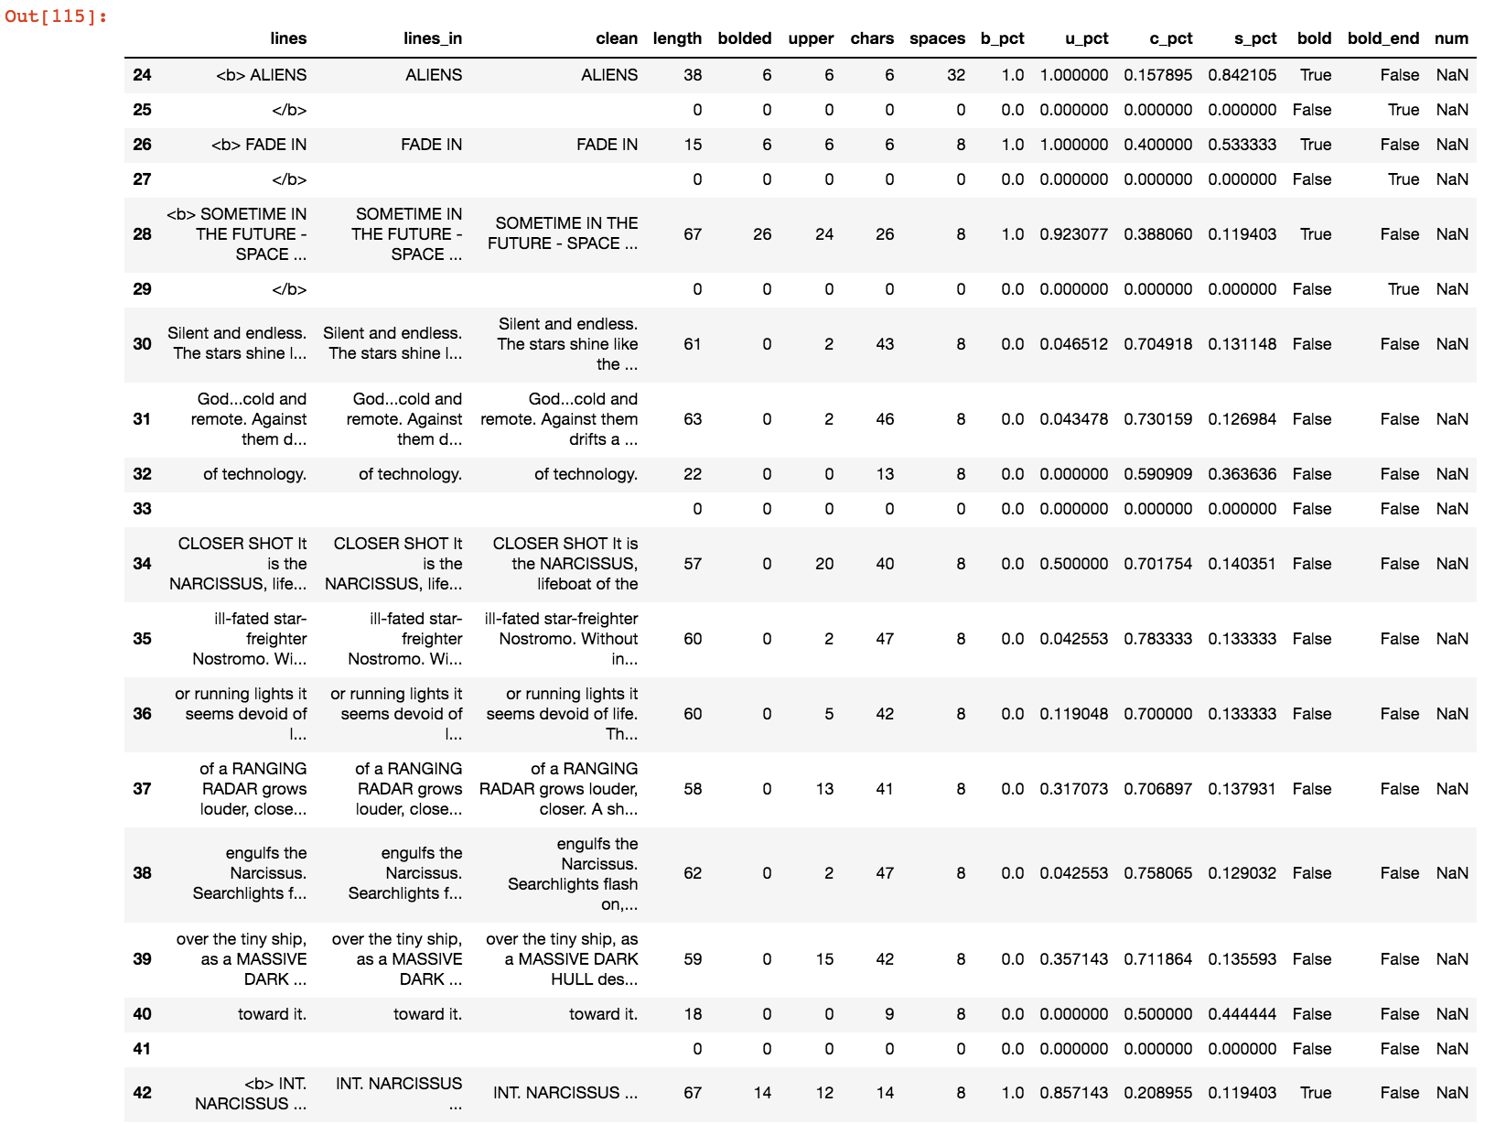
Example: Aliens (L1)
Feature Extraction:
Line length
Lead spaces
Total chars
Bolded chars
Uppercase chars
Scene/annotation numbers
L2:
Token, word, and ngram extraction
L3:
Syntax interpretation and object extraction
L4:
Object network and entity mapping

Slide 13
Current Priorities
Finish designing Script() object model and initial layer-extraction design
Create a Script() object viewer to audit, examine, and visualize object and data states
Design supervised and unsupervised structural analysis models to experiment with (and associated testing framework)
Finish merging IMDb film data to project database for metadata-enhanced classification techniques (i.e. character dictionaries)

